Slide 1

Simplifly ..
Trainer: Javeed Mohammed Husnuddin.
Presented by : Kartik Rajaram Gaware.

Slide 2
Technologies & Tools Used
Backend: Java, Spring Boot, Hibernate, JPA
Frontend: React.js
Database: MySQL
Security: JWT Authentication & Authorization
Tools & Platforms: Eclipse, STS, Postman, GitHub, Maven, Docker
Cloud: AWS EC2, AWS S3

Slide 3


Introduction
SimplyFly is an online flight booking system designed to simplify air travel booking.
Provides a centralized platform for users, admins, and flight owners.
Features: Flight search, seat selection, secure payment, refunds, and dashboards.
Ensures role-based access:
Admin – manages users, flights, refunds.
Owner – manages flights and seat availability.
User – searches, books, and cancels tickets.

Slide 4
Main Modules of Simplifly:
User Module – Registration, Login.
Flight Module – Add, Update, Delete Flights, Manage Routes, Seat Allocation.
Booking Module – Ticket booking, seat selection, ticket cancellation.
Payment & Refund Module – Online payment, cancellation refunds, refund approvals.
Owner Module – Manage flights, users, refunds.
Admin Module – Manage Roles ,See Booking , Create Admin and Owner profile.

Slide 5
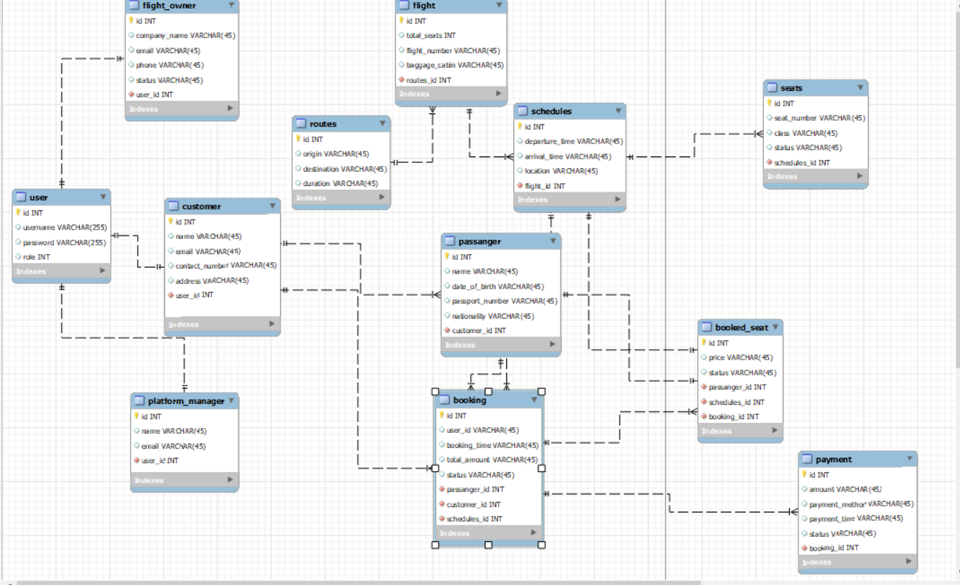
ER Diagram

Slide 6
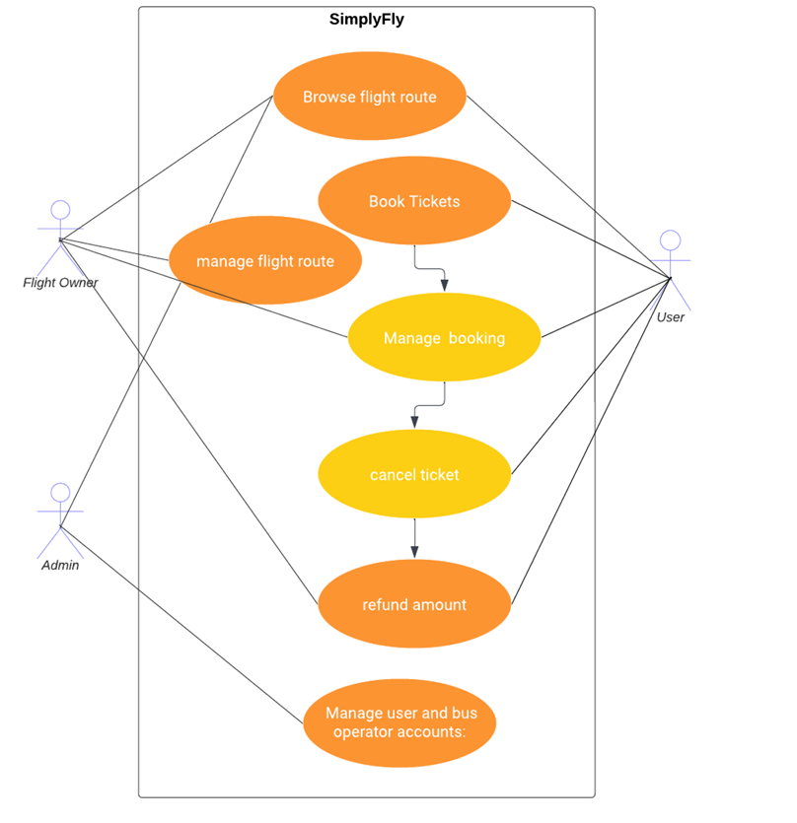
Use Case

Slide 7
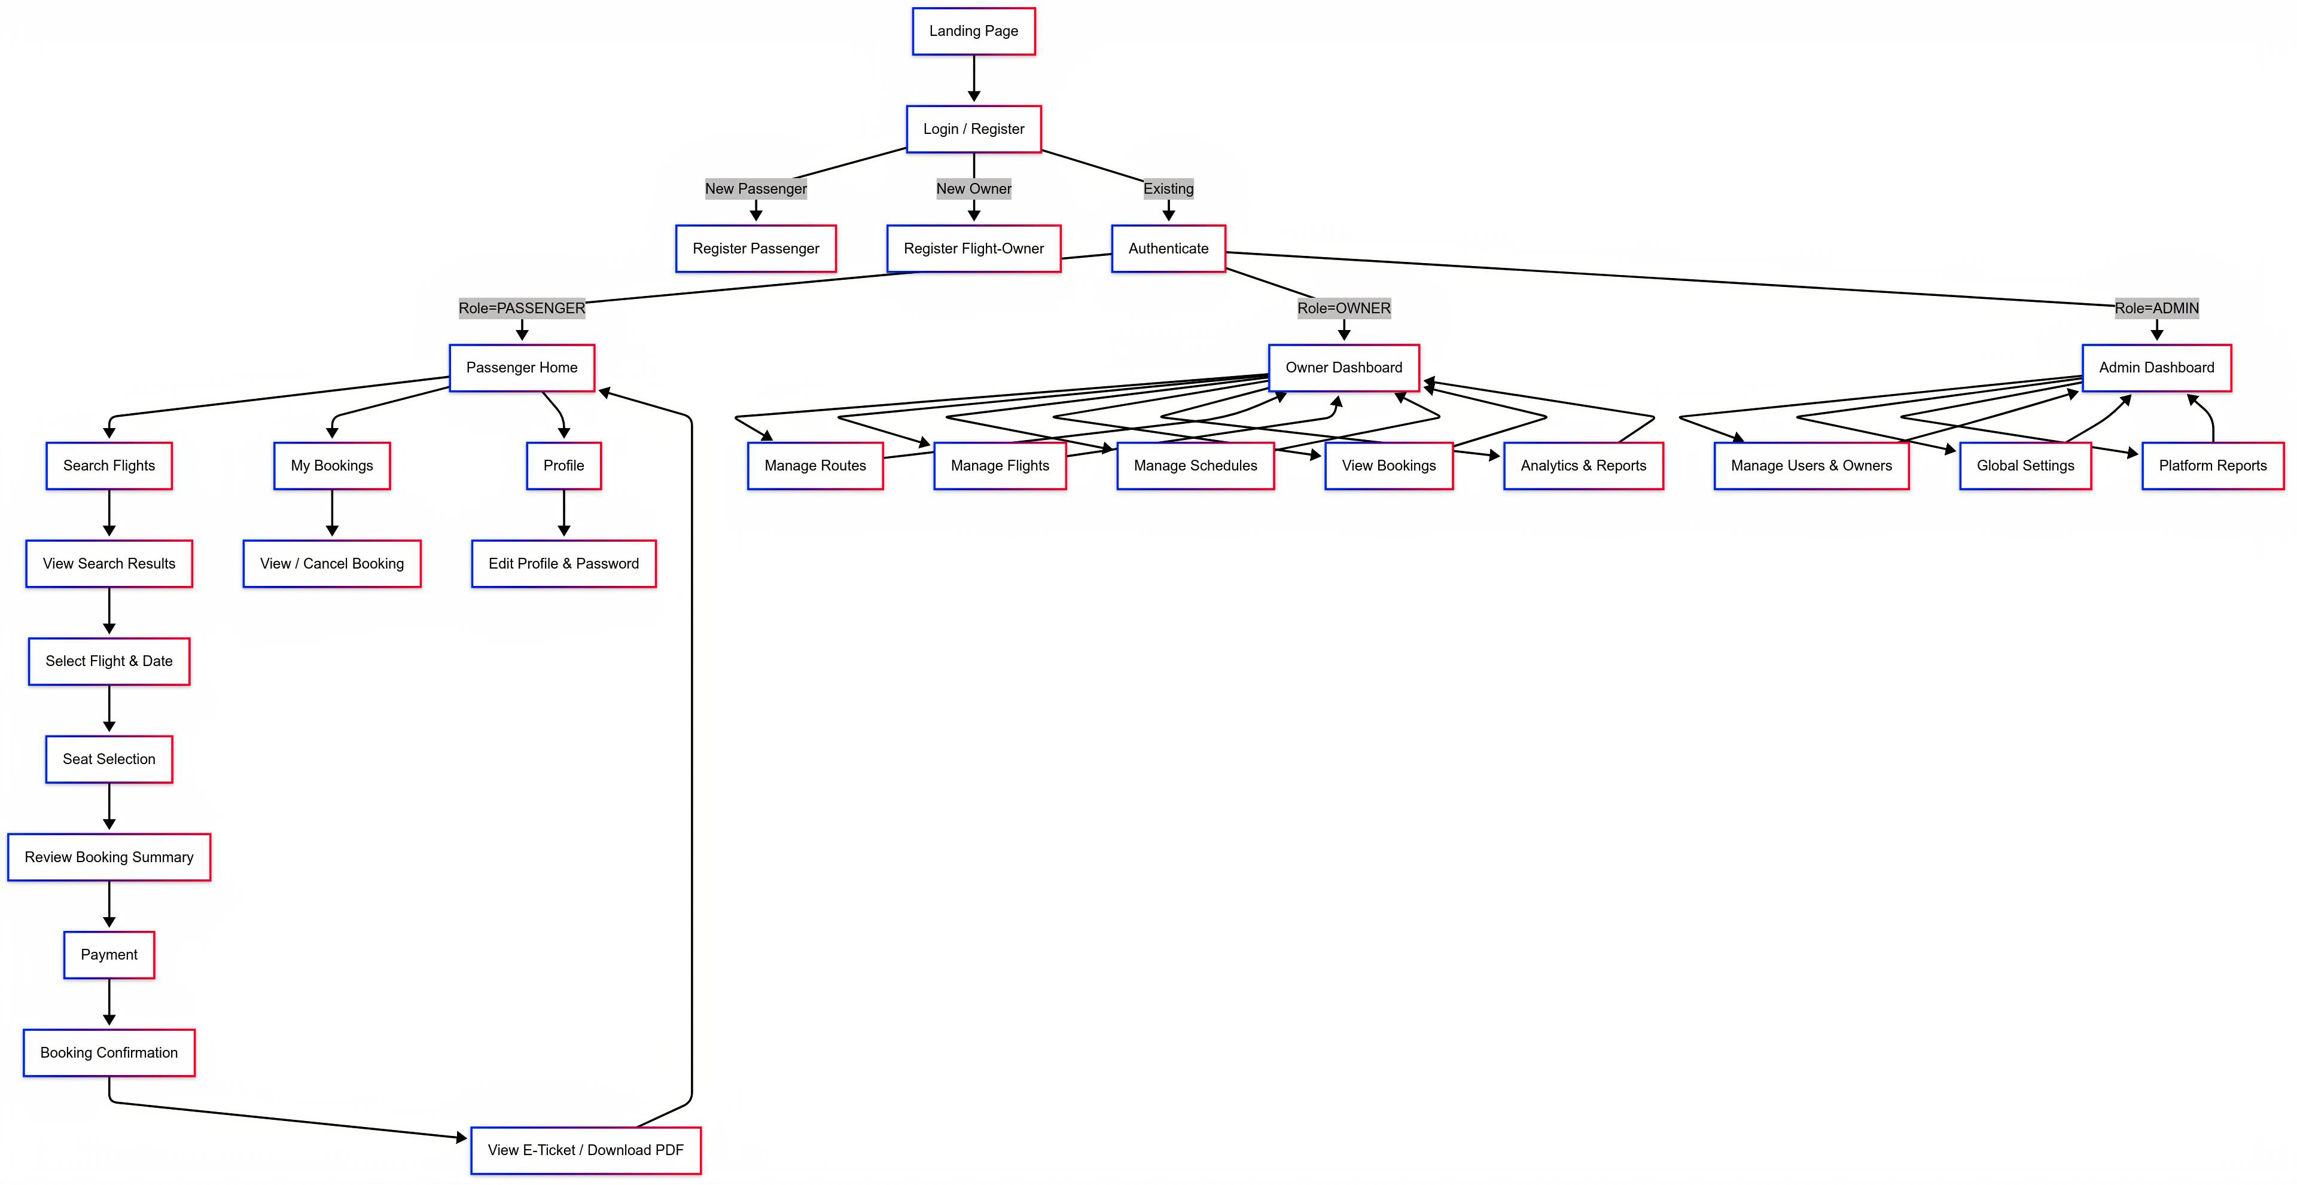
Flow Diagram

Slide 8
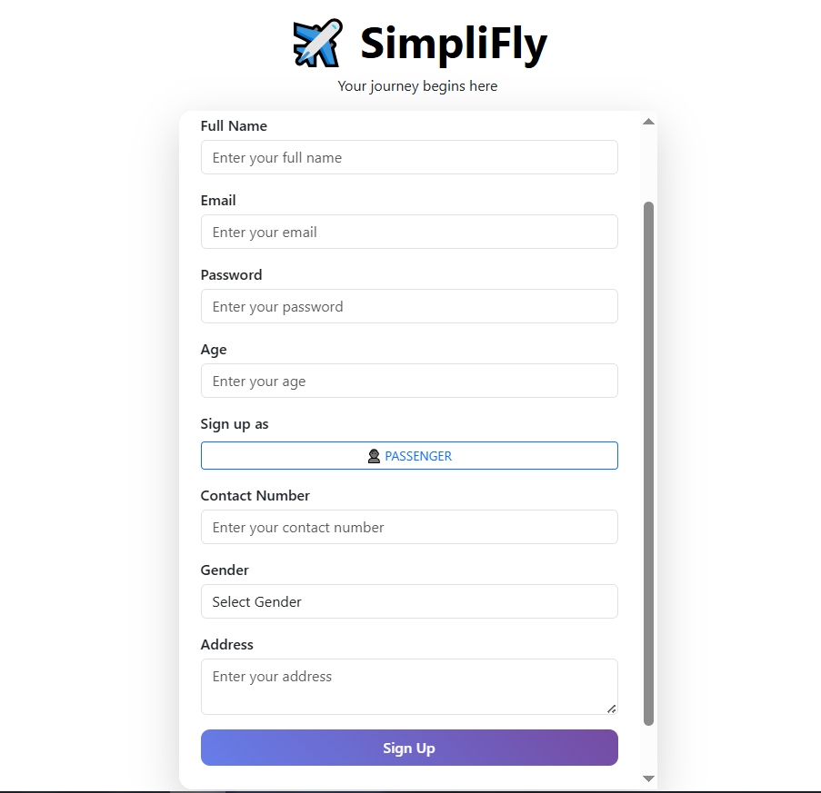
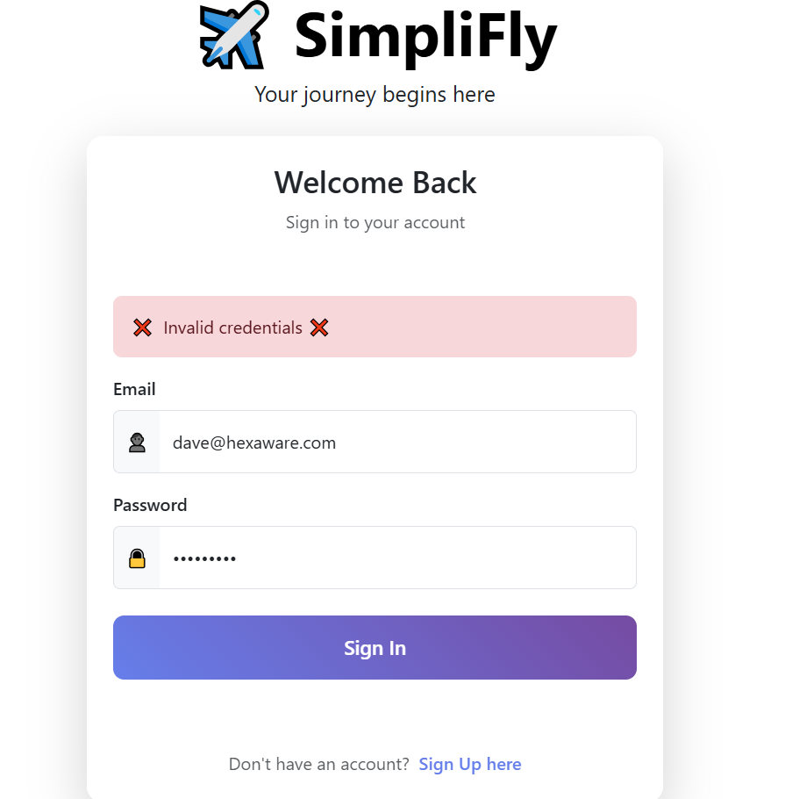
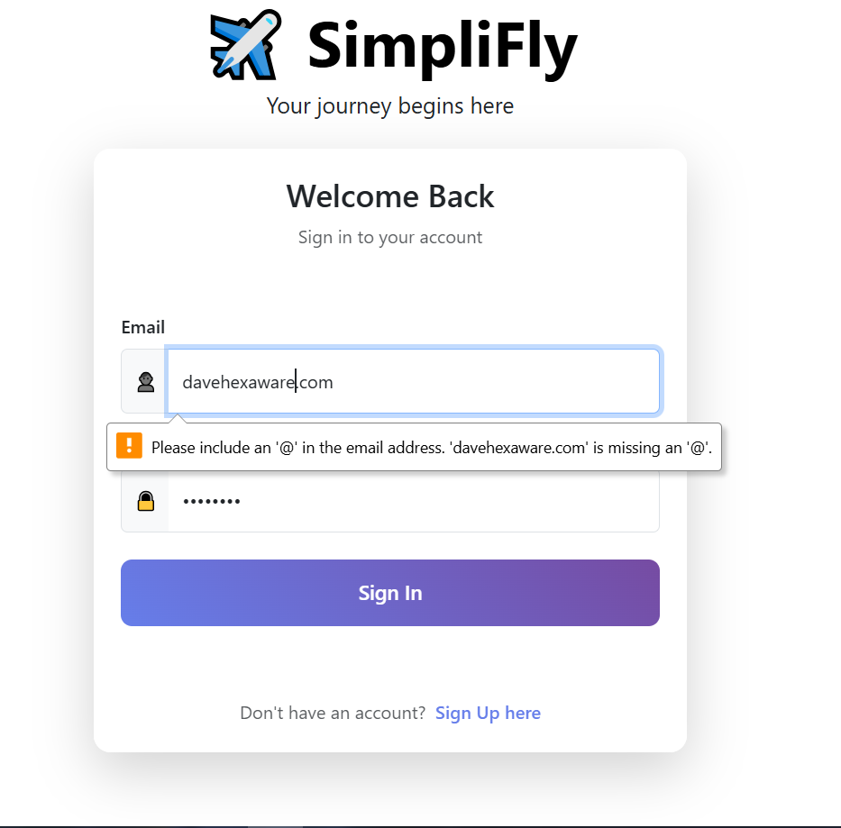
Pages of Simplify

Slide 9
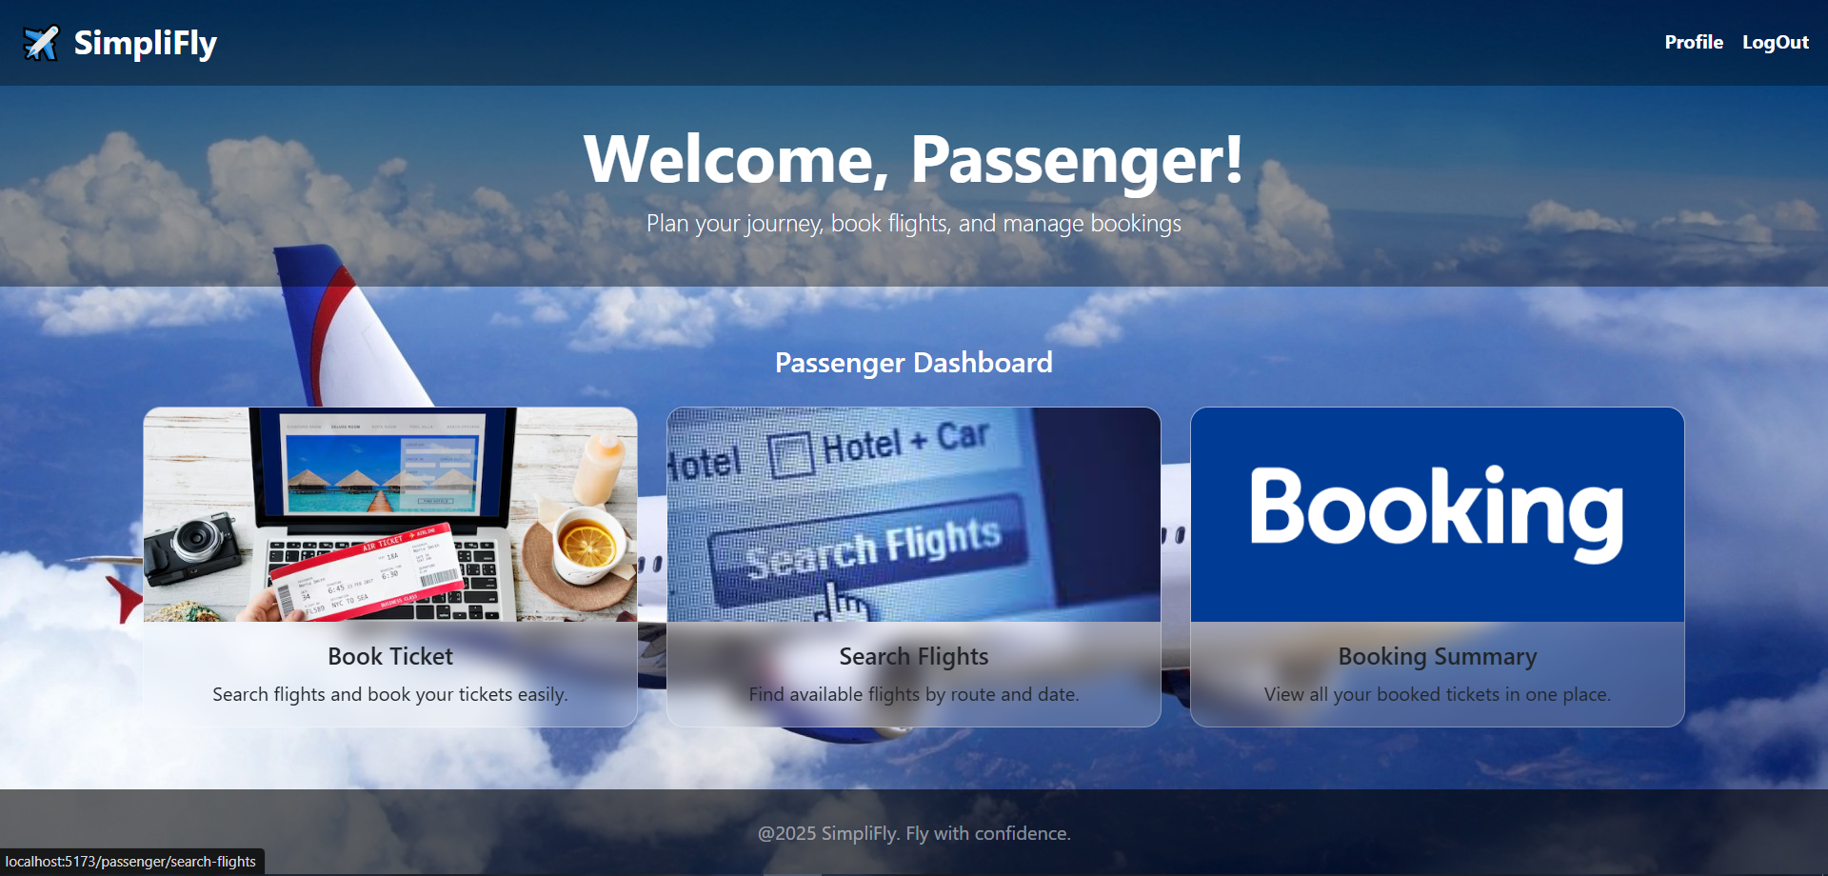
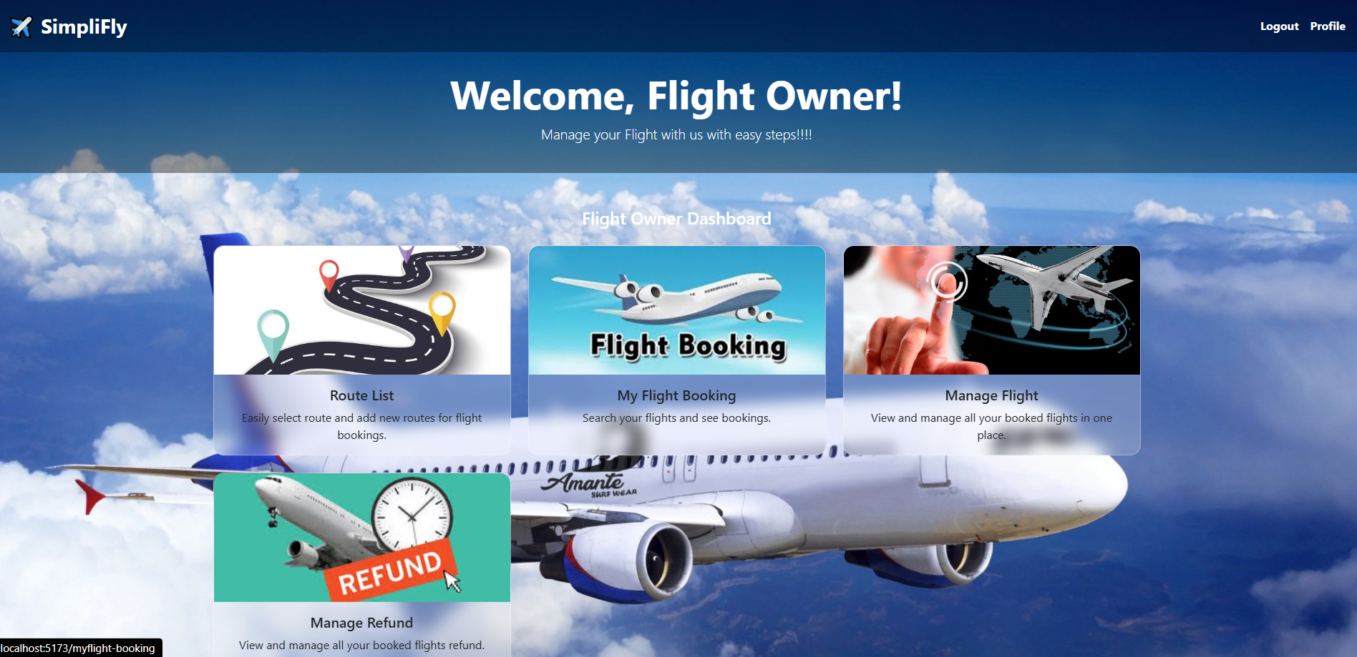
Large headline
Pages (Passenger , Flight Owner)

Slide 10
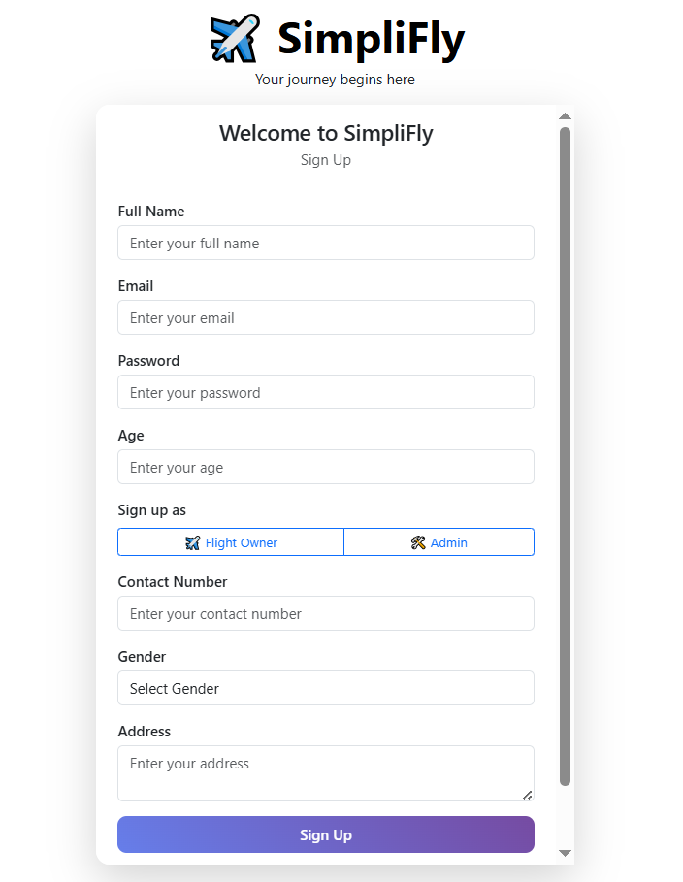
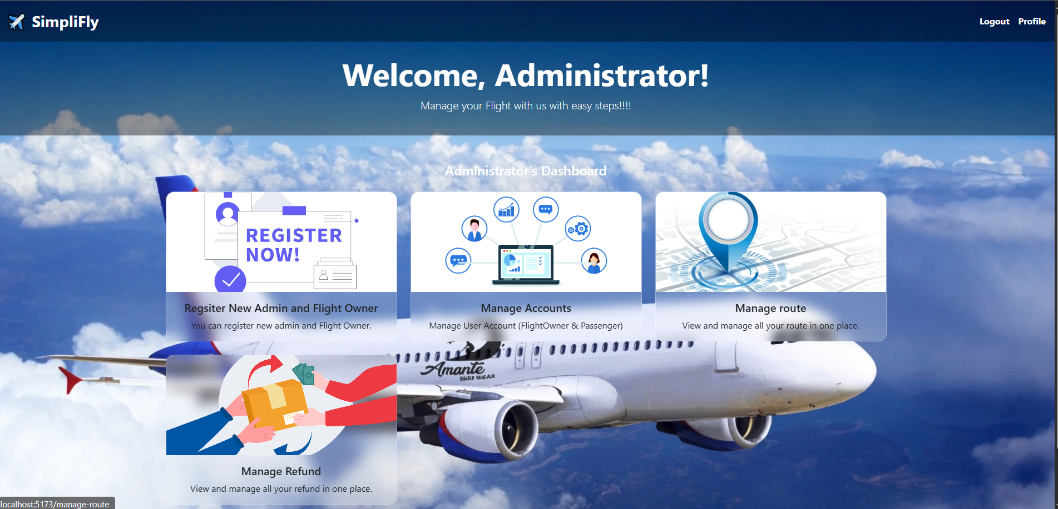
Pages (Admin)

Slide 11
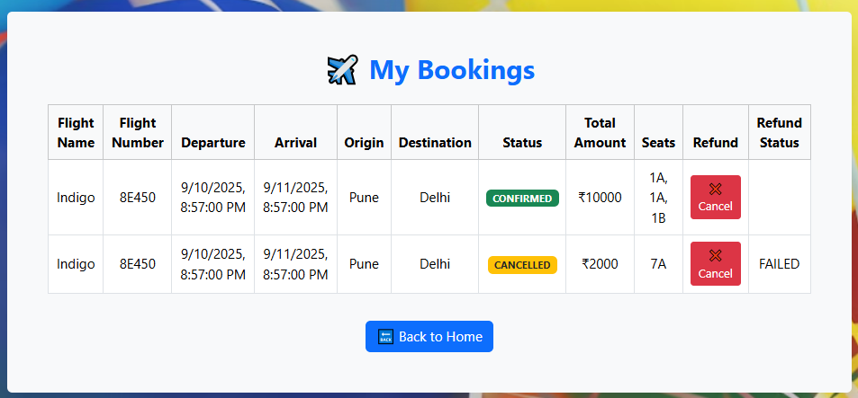
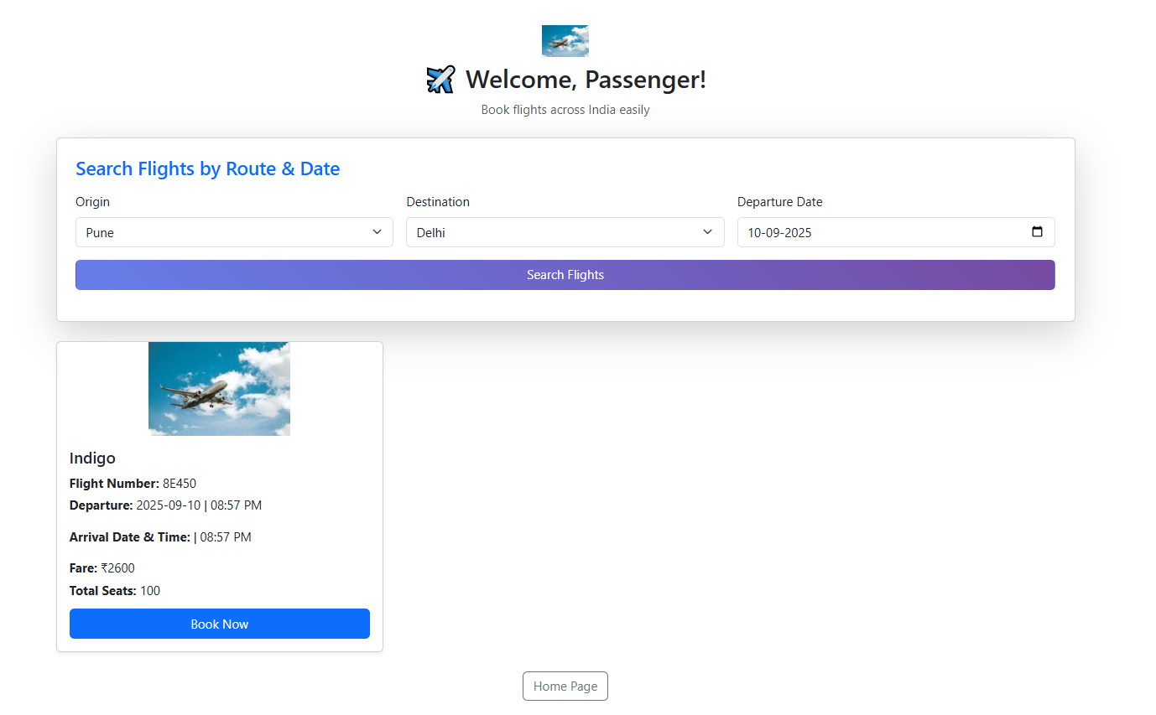
Pages (My Booking, Search Flight
& Book)

Slide 12
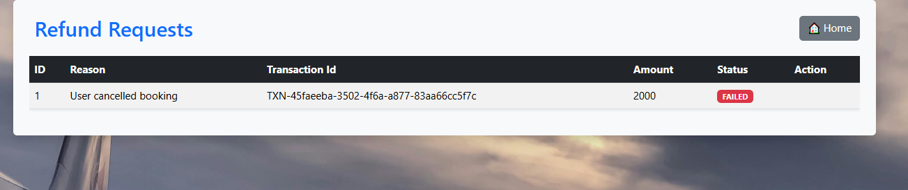
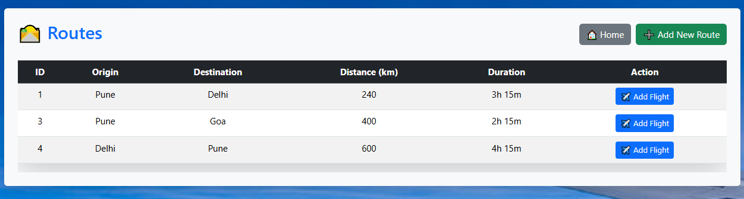
Pages (Refund & Route)

Slide 13
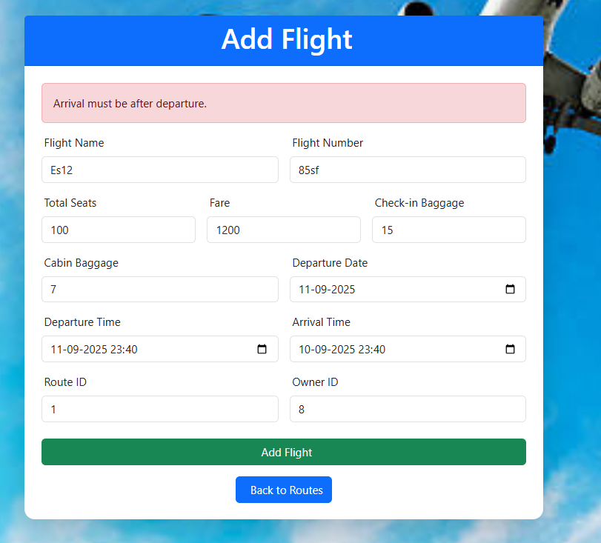
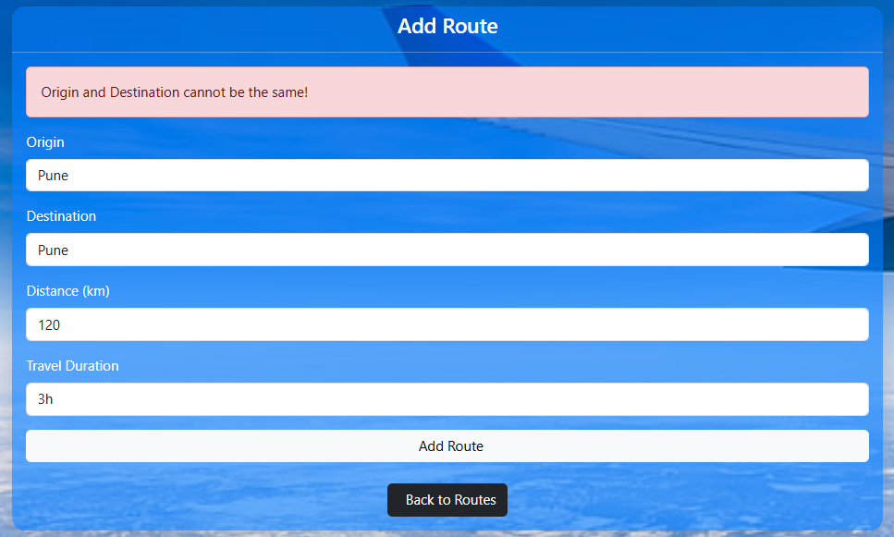
Pages (Add Flight & Add Route Validation)

Slide 14
conclusion
Simplify provides a secure, scalable, and user-friendly online flight booking solution.
Handles complete cycle: Registration → Booking → Payment → Refund.

